Slide 1
Developing and Delivering on the IT Value Proposition
Chapter 1
© 2017 Prospect Press

Slide 2
What Is IT Value?
IT Value is the worth or desirability of a thing. (Cronk and Fitzgerald, 1999)
IT Value is a subjective assessment.
IT Value is based on how a business chooses to view it.
IT Value is tied to the business model.
IT Value can be defined by ROI or KPI’s.
© 2017 Prospect Press

Slide 3
Where Is IT Value?
Decisions about IT Value may be made to optimize value to the firm even if they cause difficulty for a business unit or individual.
IT Value needs to be leveraged for the benefit of the firm.
© 2017 Prospect Press

Slide 4
Who Delivers IT Value?
IT Value is a function of people, process, and technology.
IT Value is also a function of organizational value.
Technology
Pe o
p l e
Process

Slide 5
When Is IT Value Realized?
IT Value has a temporal dimension.
Initially, companies spend a considerable amount to deploy new technology with no benefit.
Some value is then achieved by solving initial inefficiencies.
As use increases, complexity grows and costs increase.
Finally, the business is made simpler and efficiencies are achieved.

Slide 6
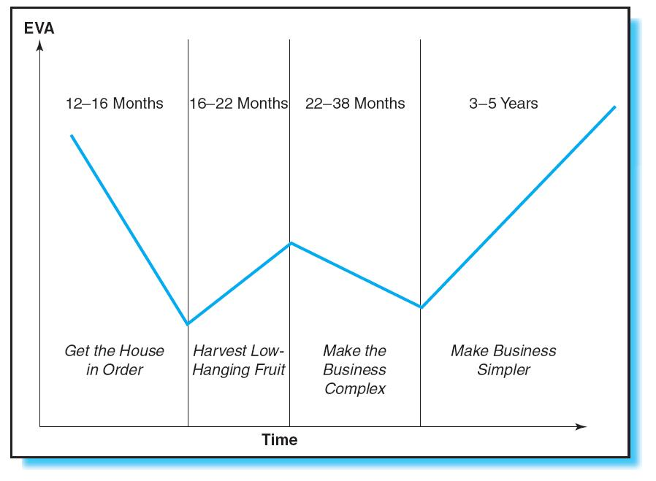
The “W” Effect in Delivering IT Value (Chatterjee and Seagars, 2002)
© 2017 Prospect Press

Slide 7
Best Practices in Understanding IT Value
Link IT Value directly to the business model.
Recognize that value is subjective, and manage perceptions accordingly.
Aim for a value “Win-Win” across processes, work units, and individuals.
Seek business commitment to all IT projects.
Manage value over time.
© 2017 Prospect Press

Slide 8
The Three Components of the IT Value Proposition
IDENTIFICATION + CONVERSION + REALIZATION = IT VALUE
© 2017 Prospect Press

Slide 9
Identification of Potential Value
Joint IT-Business mechanisms should be established to identify business and technical opportunities where IT can add value.
Establish a formal process for project prioritization.
© 2017 Prospect Press

Slide 10
Best Practices in Identifying Potential Value
Recognize and evaluate opportunities through a joint business-IT structure.
Develop a means to compare value across projects.
Utilize a portfolio approach to project selection.
Establish a funding mechanism for infrastructure.
© 2017 Prospect Press

Slide 11
Effective Conversion
Conversion is the transformation of ideas and opportunities into IT value propositions.
Excellent project management, effective execution, and reliable IT operations are critical to IT value creation.
© 2017 Prospect Press

Slide 12
Conversion Issues
More projects than resources
Insufficient time to complete all projects
Training limitations
Inadequate technical or business resources
Implementation of IT may require significant business process redesign.
© 2017 Prospect Press

Slide 13
Best Practices in Conversion
Availability of adequate and qualified IT and business resources
Training in business goals and processes
Multifunctional change management
Emphasis on higher-level learning and knowledge management
© 2017 Prospect Press

Slide 14
Realizing Value
IT Value realization is a long-term process.
To deliver Value – technology must be used extensively.
Measurement is a key component. [Does Expected Value = Actual Value?]
© 2017 Prospect Press

Slide 15
Best Practices in Realizing Value
Plan a value-realization phase for all IT projects.
Measure outcomes against expected results.
Look for and eliminate root causes of problems.
Assess value realization at all levels in the organization.
Have provision for acting on new opportunities to leverage value.
© 2017 Prospect Press

Slide 16
Five Principles for Delivering Value
Have a clearly defined portfolio value management process.
Aim for chunks of Value.
Adopt a holistic orientation for technology value.
Aim for joint ownership of technology initiatives.
Experiment more often.
© 2017 Prospect Press

Slide 17
Principle 1 – Have a Clearly Defined Portfolio Value Management Process
Track projects as they are developed.
Revisit portfolio decisions to determine if projects should be changed.
Invest in strategic and infrastructure projects.
Develop an ongoing means to ensure value is realized.
© 2017 Prospect Press

Slide 18
Principle 2 – Aim for Chunks of Value
Focus on key areas.
Deliver Value through a series of small focused projects.
Balance short-term and long-term strategic goals.
© 2017 Prospect Press

Slide 19
Principle 3 – Adopt a Holistic Orientation to Technology Value
Manage and use people, process, and technology.
Anticipate the impact of technology.
Incorporate technology changes into business changes.
© 2017 Prospect Press

Slide 20
Principle 4 – Aim for Joint Ownership of Technology Initiatives
Ensure executive sponsorship for all IT projects.
Develop a culture of joint responsibility and mutual trust between IT and the business.
© 2017 Prospect Press

Slide 21
Principle 5 – Experiment More Often
Experiment with new technologies on a small scale to minimize risk.
Experimentation enables technology investments to be made in smaller chunks.
Experimentation enables IT Value to be realized sooner.
© 2017 Prospect Press

Slide 22
Conclusion
This chapter explored the concepts and activities involved in developing and delivering IT value to an organization.
IT value cannot be viewed in isolation.
The entire IT process must be managed from conception to cash.
© 2017 Prospect Press

Slide 23
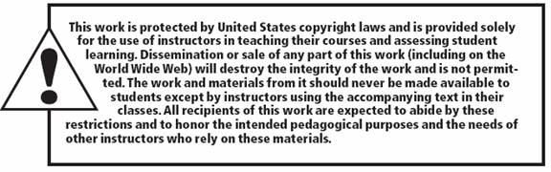
© 2017 Prospect Press
1-23

